Slide 1
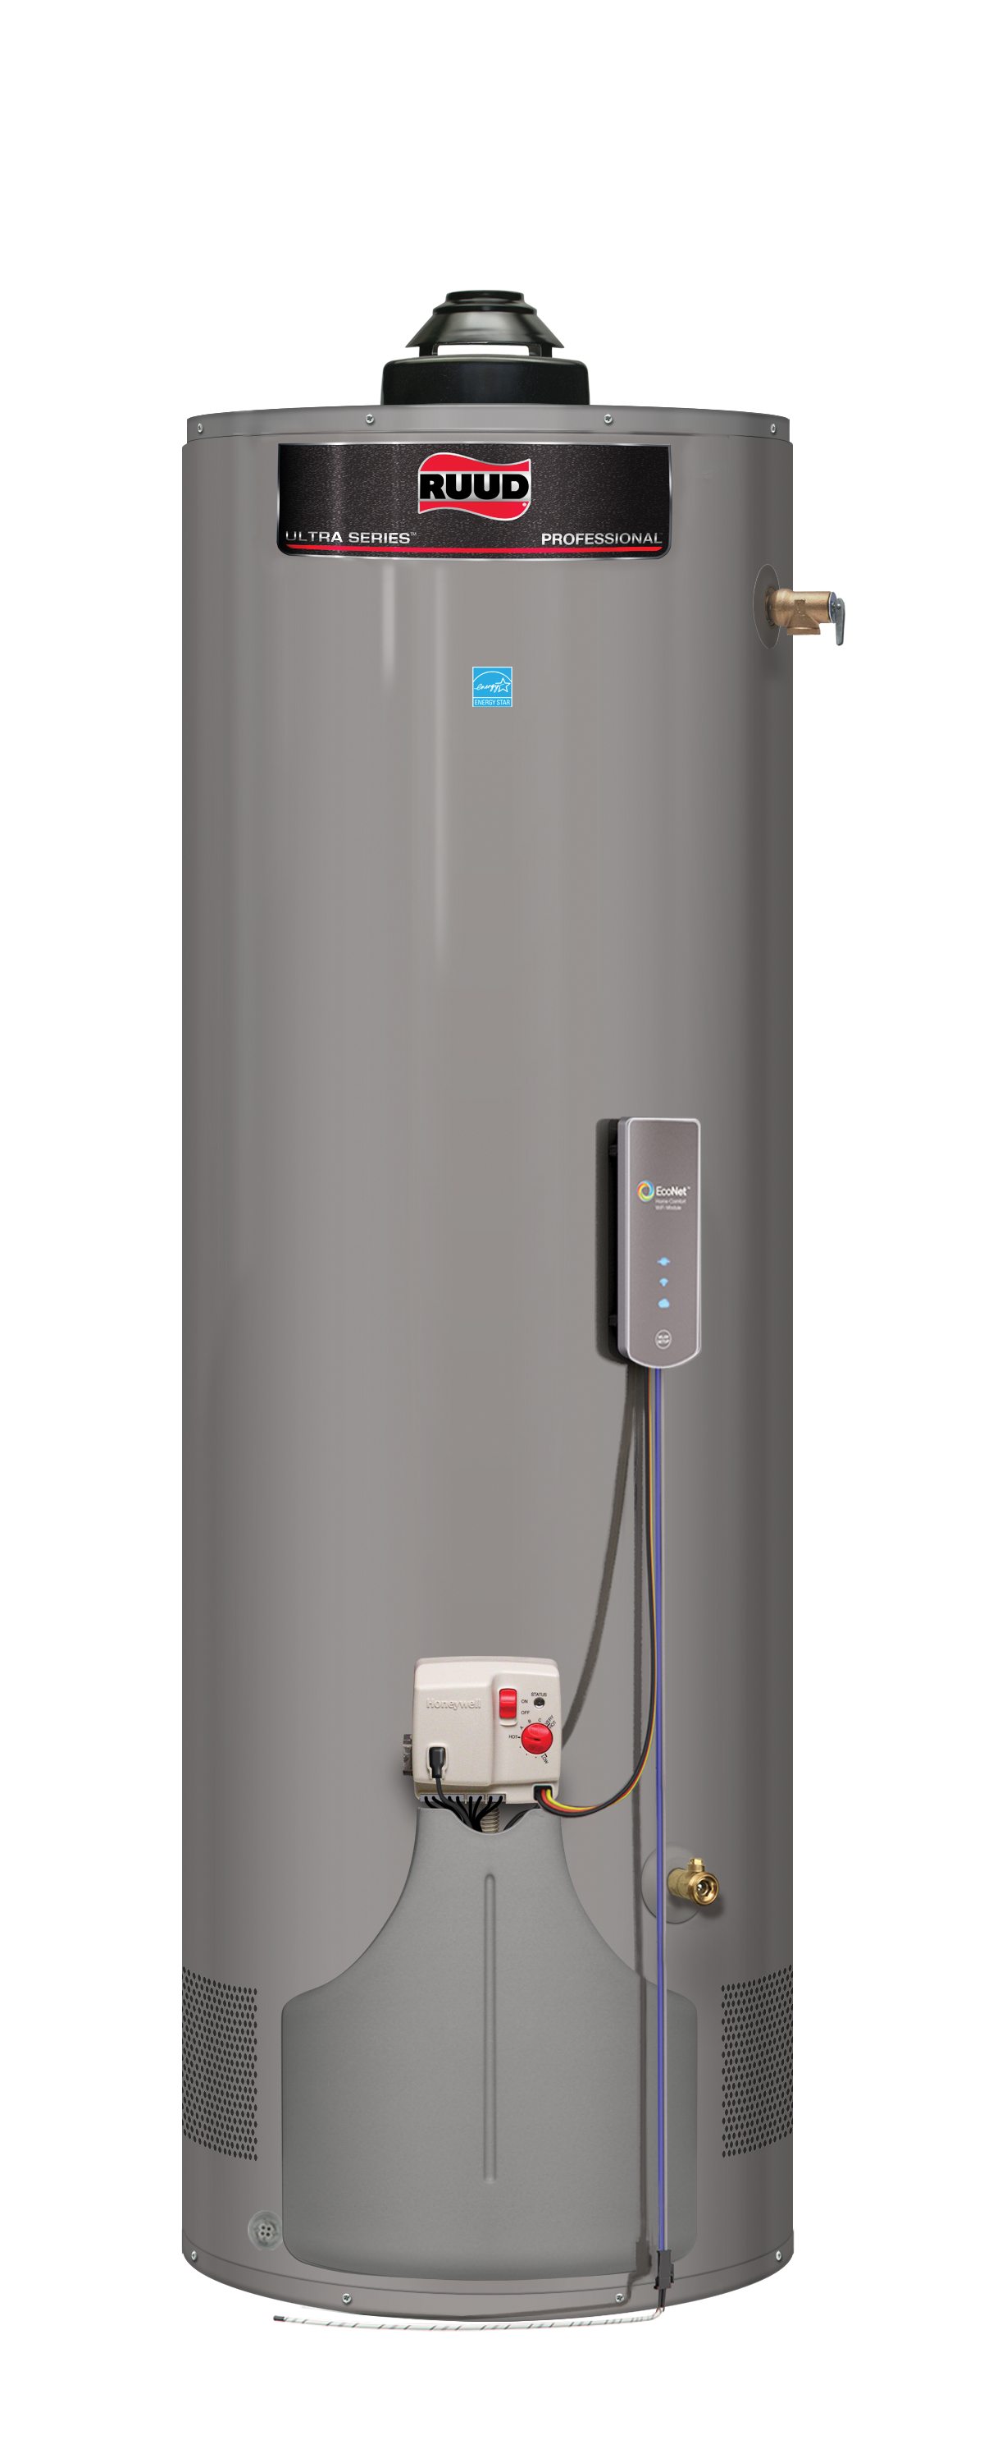
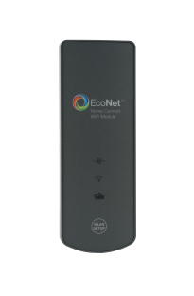
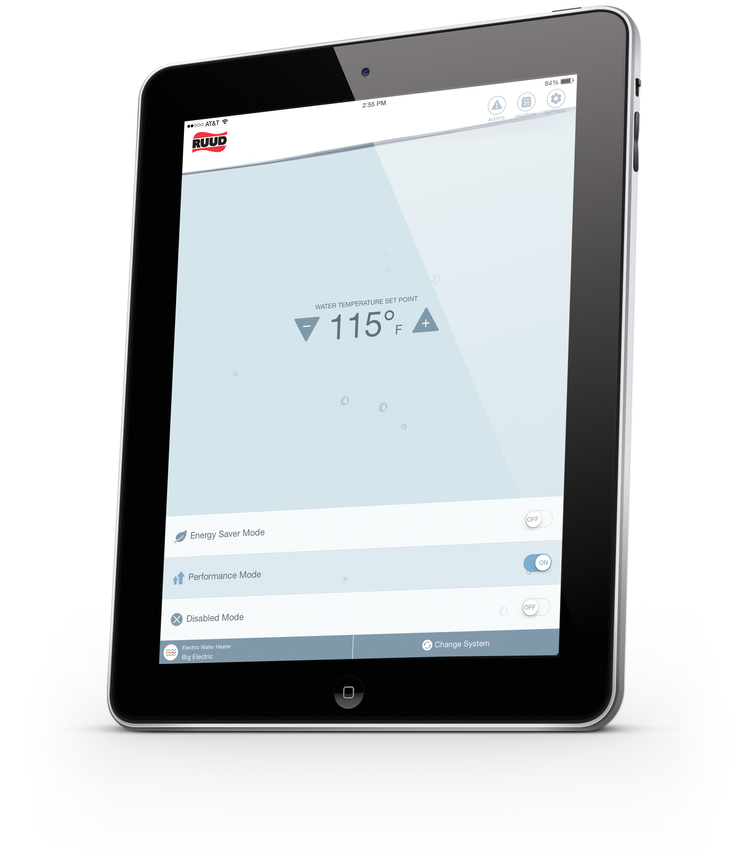
EcoNet in the Box! Remote Monitoring For Your Ruud Water Heaters
The Ruud Wi-Fi Module is now included on select models

Slide 2
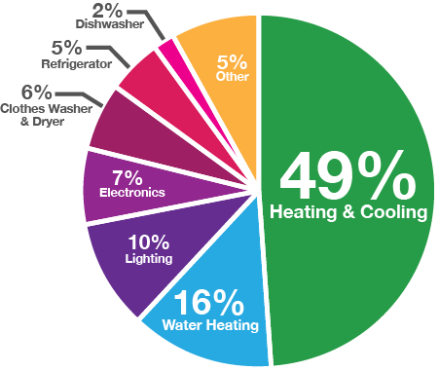
Why EcoNet
Ruud is the only company who can help a homeowner control 65% of their home’s energy usage.
Notes:
65% + of a home’s energy are consumed by products we make – HVAC and water heating
We’re the only company who can help a homeowner control 65% of their home’s energy usage.

Slide 3
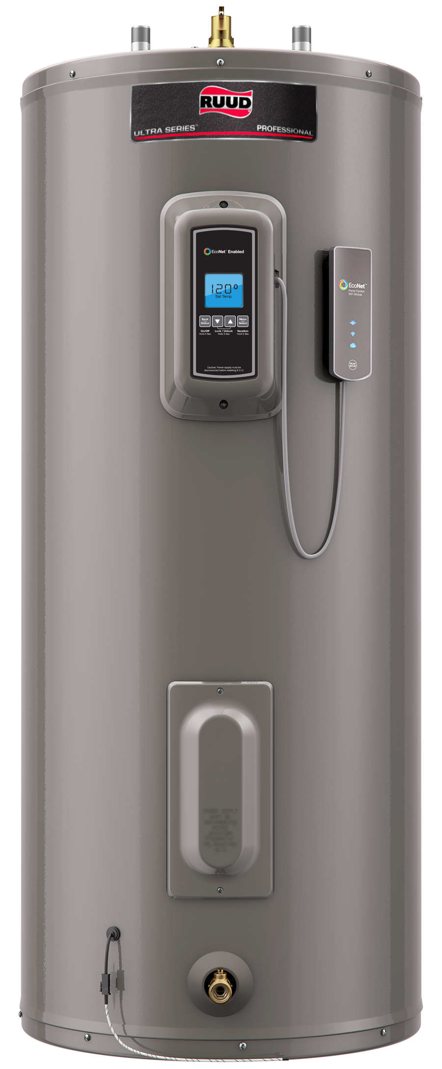
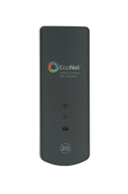
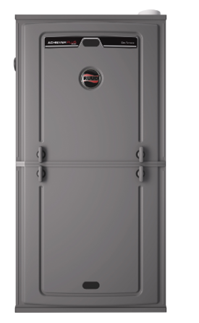
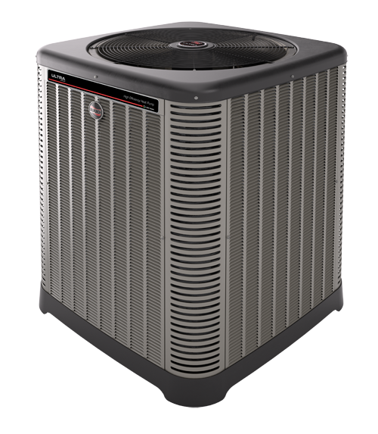
What is EcoNet?
EcoNet™ is a new technology from Ruud that gives homeowners convenient access to their equipment settings and alerts them if there is ever a problem with their equipment
Select water heater models come with the EcoNet WiFi Kit inside. Once installed the WiFi Kit allows home owners to use the EcoNet iOS or Android smart phone app to manage their hot water heater
WiFi Kits can be used with any EcoNet Enabled product, including select HVAC systems, and multiple water heaters can be viewed on the App once each system is installed

Slide 4
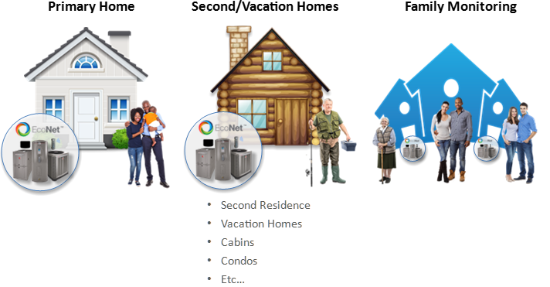
EcoNet Customer Demographic

Slide 5
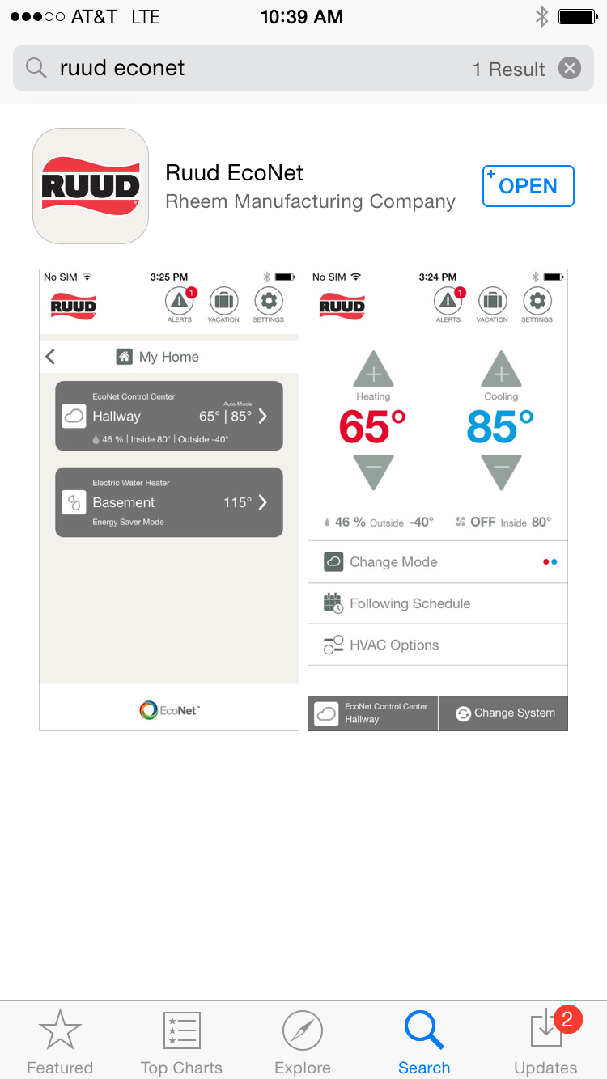
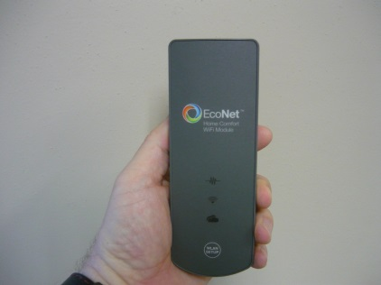
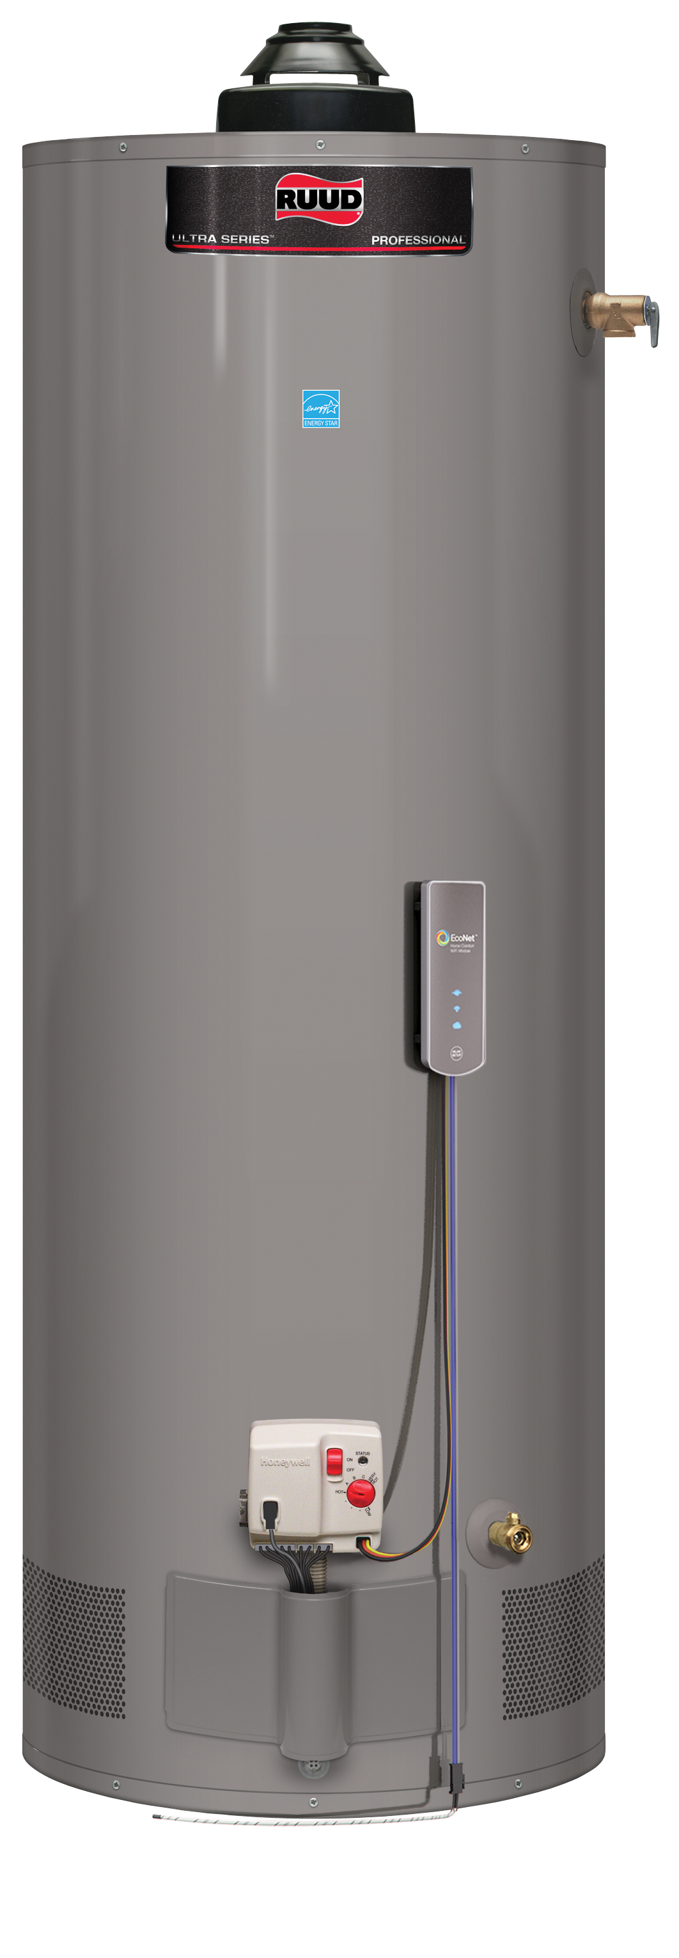
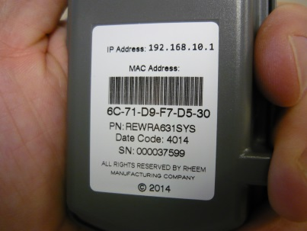
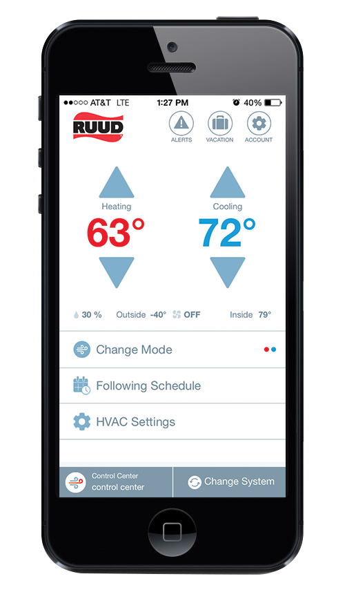
Installing the System
^{STEP ONE}
Download the FREE EcoNet mobile app available from Apple iTunes or Google Play stores to your smart phone or tablet.
^{STEP TWO}
Installation and setup is quick and easy. Just follow the step-by-step instructions provided in your EcoNet WiFi Kit package.
^{STEP THREE}
Use the EcoNet mobile app to adjust temperature settings, monitor diagnostics, receive alerts, and schedule vacation

Slide 6
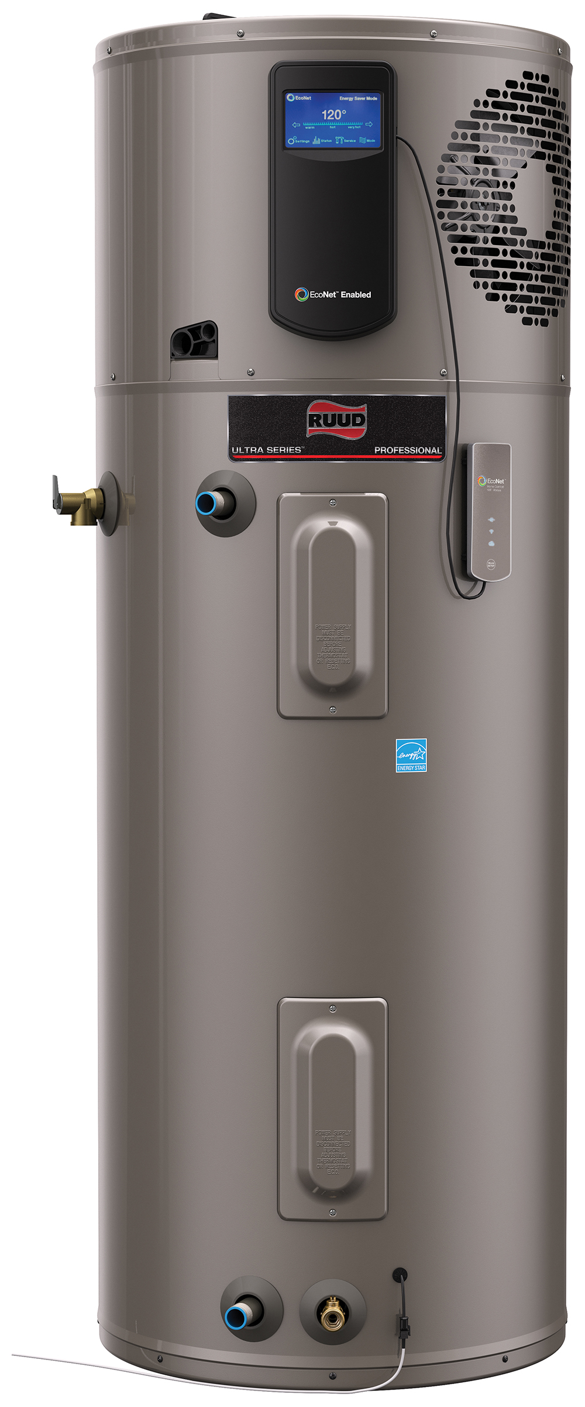
EcoNet Wi-Fi Module Kit Now Included in Select Water Heater Models
Ultra Powered Damper & ultra Low Nox Gas
Ultra Electric
Ultra Hybrid Heat Pump

Slide 7
Questions?

